Slide 1
Product
Management system
Under the guidance of
Mrs.P.Indumathi, MCA., M.Phil., B.Ed.,
Assistant Professor
By
RAMANA KRISHNAN V
221DA019

Slide 2
Abstract
Duration: 15 Days (20.05.2024 - 30.05.2025)
Supervisor: Mr. Boopathi, Team leader
During my Summer Internship program at Malar Electronics, I acquired substantial knowledge of the Python library pandas, which is essential for data analysis and data cleaning.
Additionally, under the guidance of Mr.Boopathi, I developed strong skills in SQL (Structured Query Language), learning commands and clauses such as JOIN, WHERE, GROUPBY, and ORDERBY to perform exploratory data analysis using SQL Server.
For my project, I applied my knowledge of pandas and SQL to develop a user-friendly GUI service application.

Slide 3
About the company
Malar Electronics is an embedded solution provider based in Chennai, managed by highly skilled technical team with more than a decade of experience in product designing and development. The areas of specializations are embedded product design, development, upgradation, functional substitution and PCB designing. Malar Electronics provides innovative and cost-effective embedded solutions that include hardware, software, firmware and PCB design. Their experience makes your product run to time and cost. They take product from Ideas through to manufacture. To ensure their clients recognition and reliability, they are committed to continuous improvement. Their broadband of expertise covers various domains and technologies.

Slide 4
Introduction
Internship Focus: Developed skills in the Python library pandas and SQL for data analysis and data cleaning under the guidance of Mr. Boopathi at Malar Electronics.
Project Objective: Created a user-friendly GUI service application using Python's tkinter library to efficiently search and manage data within an Excel file containing product details, repair records, and defective components.
Technical Implementation: Integrated pandas and SQL for data retrieval and manipulation, utilizing tkinter for the interactive interface, and included features for data export and user security.
Outcomes and Learning: The project streamlined data management and reduced manual effort, enhancing administrative efficiency and promoting digital management, while significantly improving technical skills.
01
02
03
04

Slide 5
Features
Basic information
Language used: Python
Coding Tool used: Spyder
Type: Desktop Application
Format of the file used: .xlsx
Search for an data
Add data
Export the file in desired location
Add users and password

Slide 6
import tkinter as tk
import sqlite3 as sq
import pandas as pd
conn = sq.connect("database_file.db")
df = pd.read_excel(filename)
df.to_sql("table1", conn, if_exists="replace" )
display_query = f"SELECT * FROM table1 WHERE \"{column}\"='{val}'”
data = curs.execute(display_query)
sql = pd.read_sql("SELECT * FROM table1", conn)
sql.to_excel(filename, index=False
Sample
Coding
The required libraries are imported i.e., tinker, sqlite3, pandas.
Connecting the database. Reading the Excel file, converting into Dataframe.Updating the database with the Dataframe.
Executing the query
Converting SQl into the excel

Slide 7
pass_file=pd.read_excel("password.xlsx")
op_pass={row['Username']:row['Password']
for i,row in pass_file.iterrows()}
user_pass = {
"admin":"admin@123",
"guest":"",
"Guest":"",
"Admin":"admin@123"
}
user_pass.update(op_pass)
Sample
Coding
The credentials are give in the password Excel file and the values in the password.xlsx is converted into a dictionary. And further it appended into the main used id and password.

Slide 8
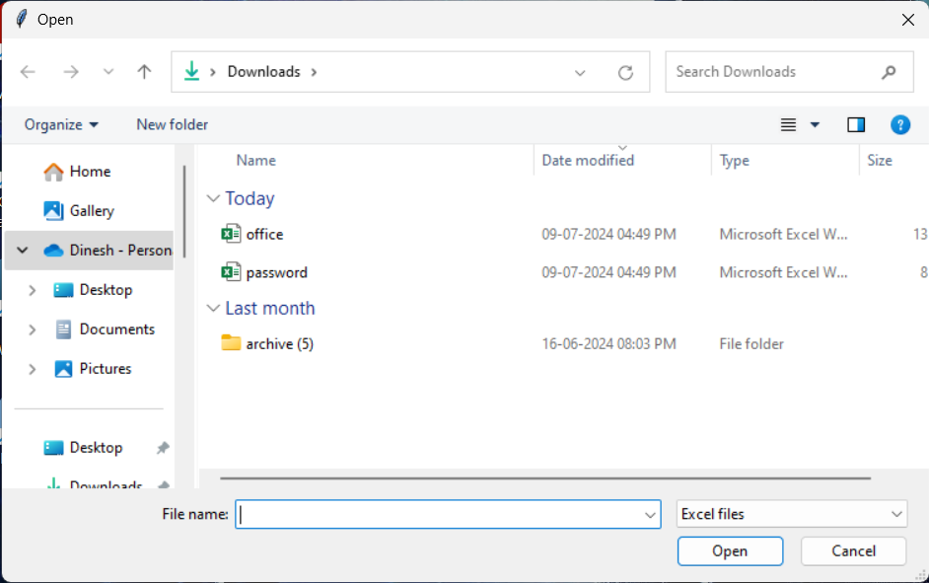
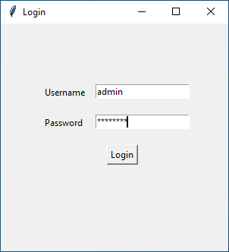
Screenshot
Selecting the file and using the Credentials

Slide 9
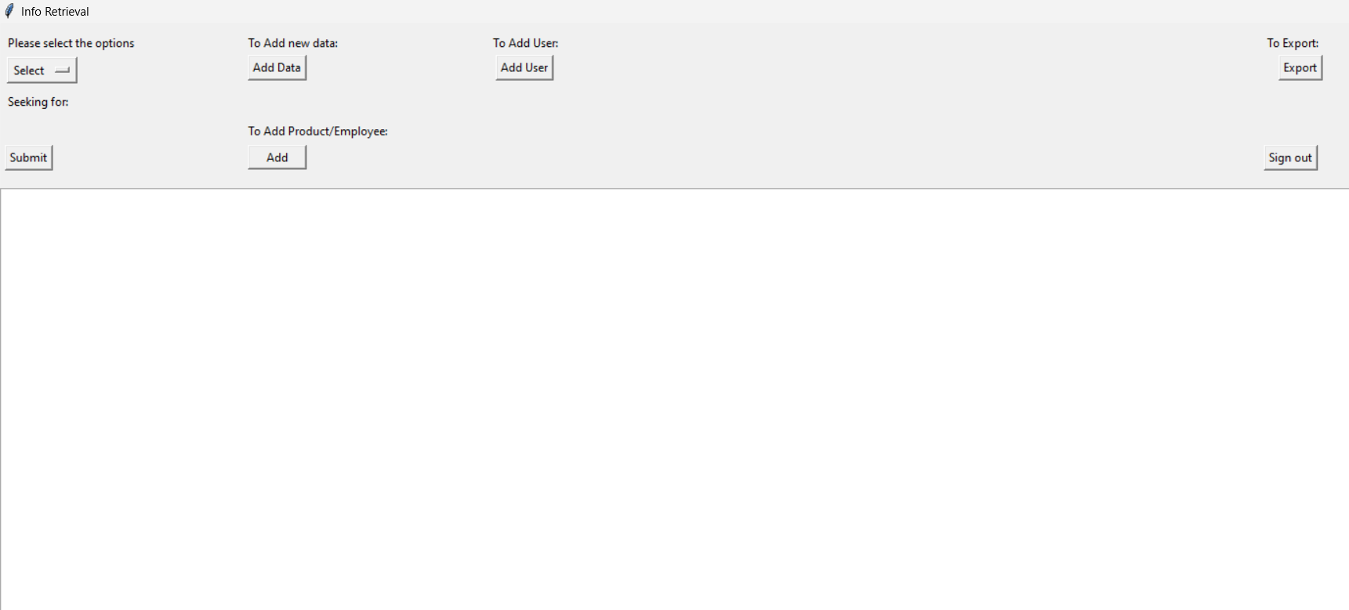
The Main window

Slide 10
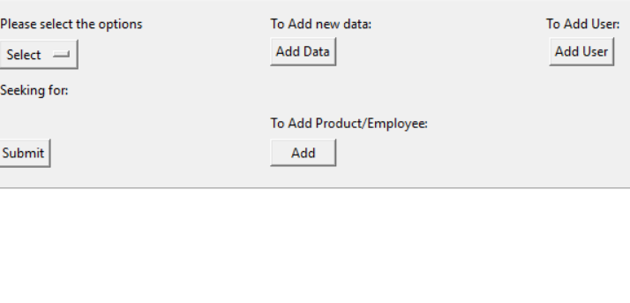
Buttons of the Main window

Slide 11
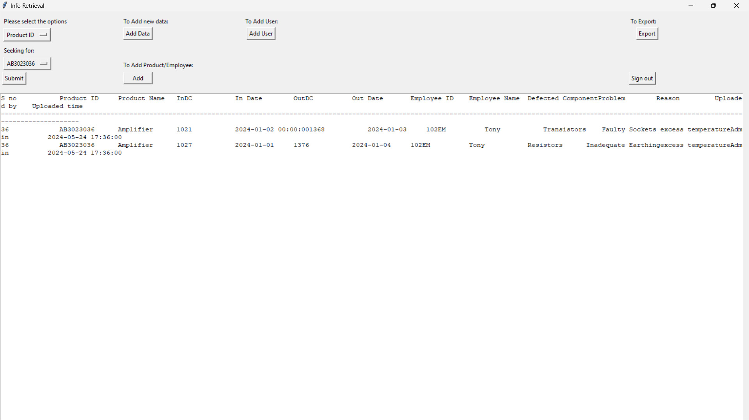
Result Window

Slide 12
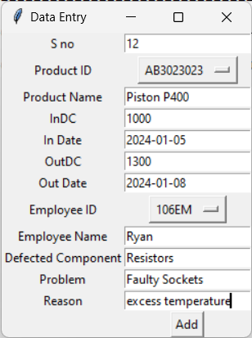
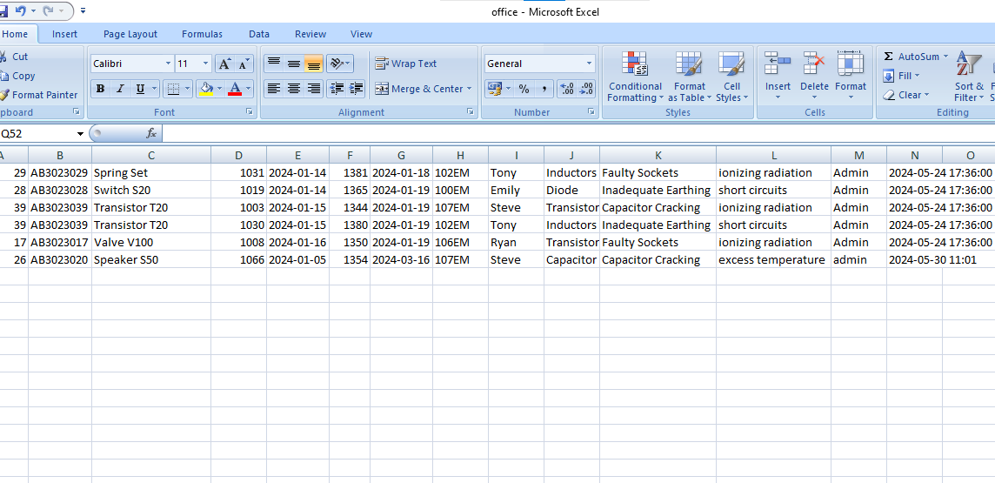
Added Data in the Excel file

Slide 13
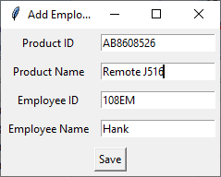
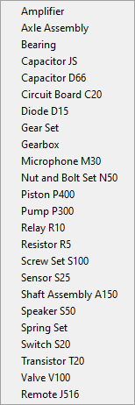
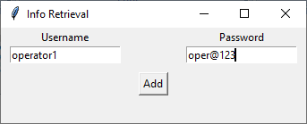
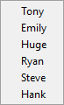
Adding Users with Password
Adding Product and Employee

Slide 14
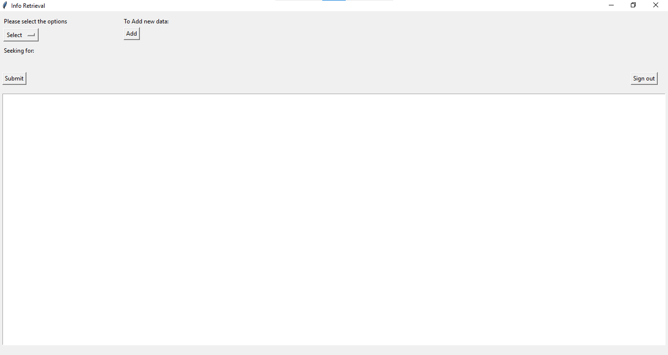
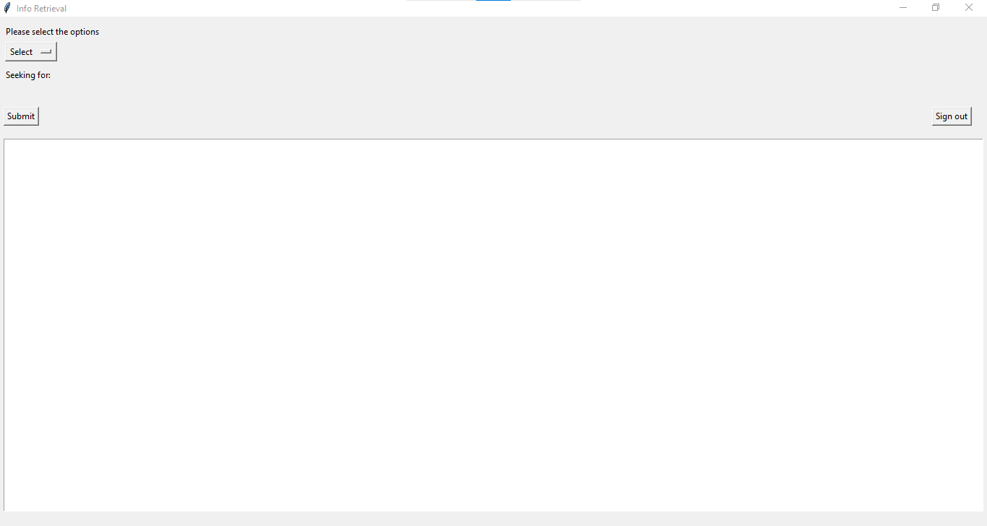
Main window in different login

Slide 15
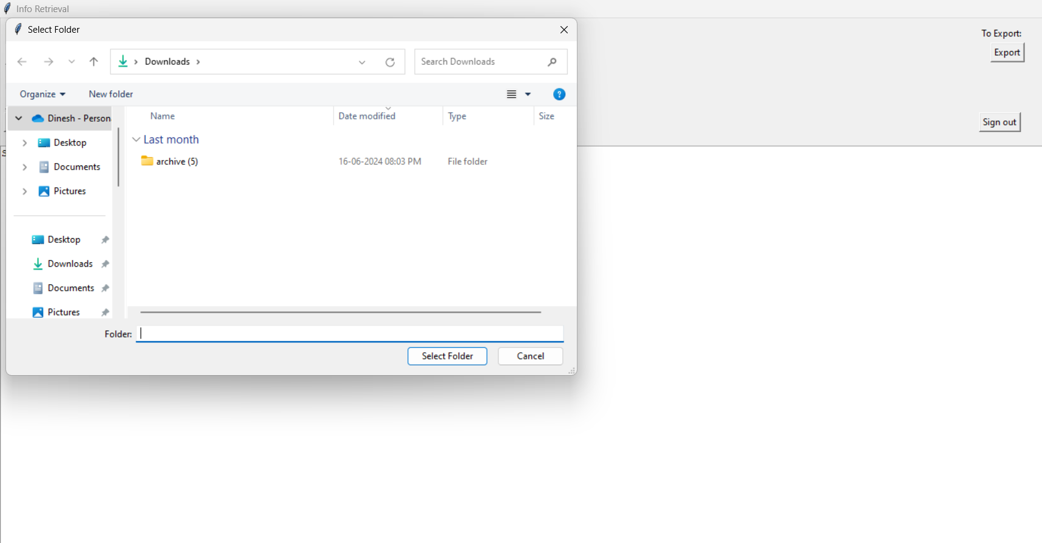
Exporting the file in the desired location

Slide 16
Conclusion
The service application can be used by the Company to maintain their product and employees records easily. Achieving this objective is difficult using the manual system as the information is scattered, can be redundant, and collecting relevant information may be very time-consuming.
There are several areas where future enhancements can further improve its functionality and user experience by adding Advanced Search Filters, Data Visualization, Automated Reports, Role-Based Access Control, M.mobile Compatibility, Enhanced Data Security, Performance Optimization

Slide 17
Thank you…

